Slide 1

Rockbuster Stealth LLC
Online Video Service Launch Strategy
Created by Joseph Sharp
Visualizations created using Tableau Public

Slide 2
Overview
In order to stay competitive with online streaming platforms such as Netflix and Amazon , Rockbuster Stealth LLC has decided to transition their existing movie licenses into the launch of an online video rental service.
The following questions were provided by the Rockbuster Stealth Management Board as key questions that would contribute towards the development of their 2020 company strategy and rental service launch Stategy.
Which movies contributed the most/least to revenue gain?
What was the average rental duration for all videos?
Which countries are Rockbuster customers based in?
Do sales figures vary between geographic regions?
Where are customers with a high lifetime value based?

Slide 3
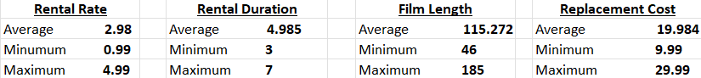
Data Overview
Total of 599 Customers.
109 Countries serviced.
1000 Different Films Options.
17 Different Genres
1 Language Option, English
Key Statistics

Slide 4
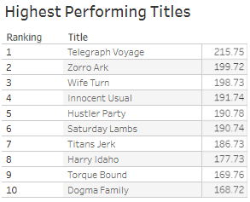
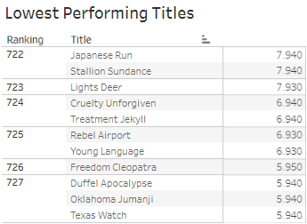
Which movies contributed the most/least to revenue gain?

Slide 5
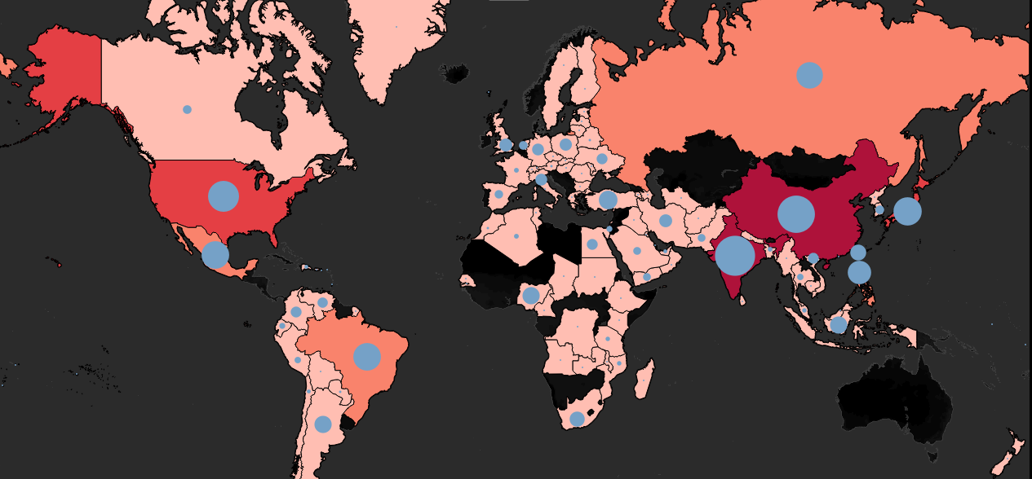
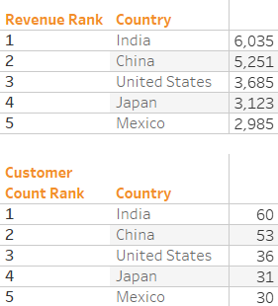
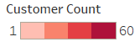
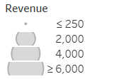
Which Countries are Rockbuster Stealth LLC Customers Based in?
RockBuster LLC operates globally. It’s largest customer bases can be found in Asia and North America.
India & China make up 19% of the global customer base.
RockBuster’s highest revenue figures are also reported in Asia and North America.
India & China similarly bring in 18.5% of Rockbuster’s global revenue.

Slide 6
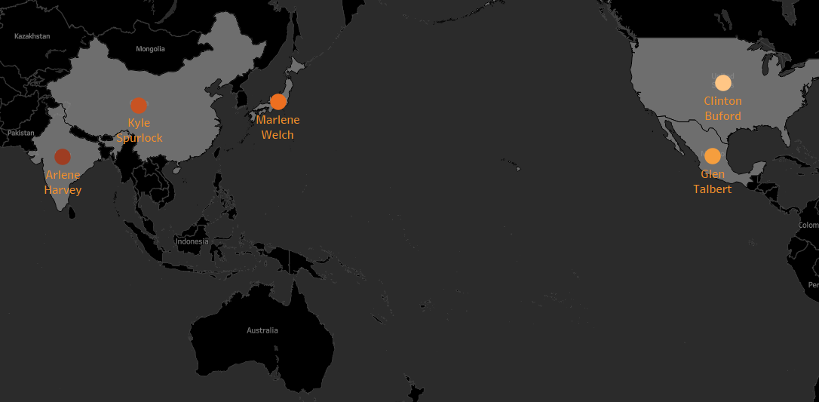
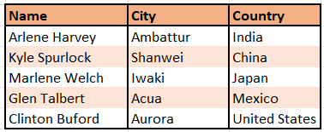
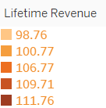
Most Loyal Customers within Top 10 Countries
Using a Loyalty or Reward program to incentivize usage would be a great means of driving engagement for the new platform
The current top 5 highest value clients in our top countries have been highlighted below.

Slide 7
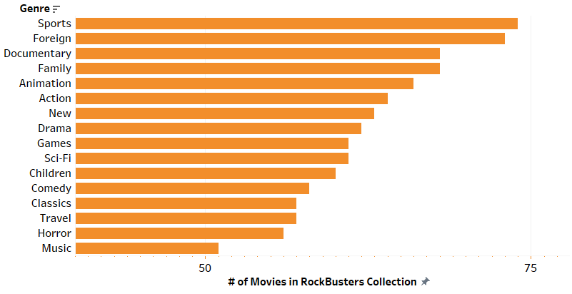
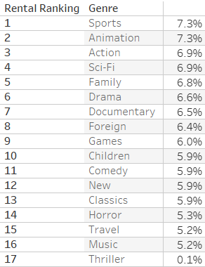
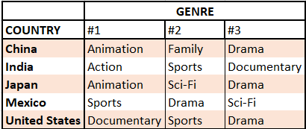
Genre Popularity
Sports Movies are Rockbuster LLC’s largest category in terms of available titles.
Sports Movies also are joint first for the most frequently rented genre (7.3% of all rentals, or, 1179 total rentals)
Other Genres in high demand;
- Animation
- Action
- Sci-Fi
- Family
Increasing the movie options in these categories could result in additional rentals.
Foreign and Documentary have an abundance of titles, but are not rented as frequently in specific regions. Scaling back on some of the available options in this category could save Rockbuster some licensing overheads.
Ensuring that Rockbuster’s Movie Catalogues expand with local tastes in mind will be key to each regions’ growth.

Slide 8
Findings and Recommendations
Based on statistics for Rental rate and rental Duration, the average film rental brings in $14.85 revenue.
Rockbusters Largest client base is focused in Asia and in North America (specifically the United States & Mexico).
Ensuring that clients in these regions are successfully migrated over to the new Rockbusters Rental platform is pivotal as they comprise some of the highest value customers.
New Platform adoption can be boosted by the introduction of Loyalty Programs.
Rockbuster Stealth has a wide customer base with varied genre preferences in each region. Rockbuster should cater marketing efforts in each region to demonstrate the

Slide 9
Thank you for your time!
If you have any questions, then please feel free to reach out to me using the contact details below. PH# 111-222-3333
Josephsharp@email.com
Links to tableau visualizations can be accessed here:
Customer Loyalty Map
Temporal maps
Genre Charts
Revenue Tables

